Slide 1
GREATER ACCESS TO AFFORDABLE EDUCATION THROUGH FINANCE
Andrea Santiago, Akshitha Singathi, Raymond Otoadese, Noelia Vazquez

Slide 2
Our Problem
The intersection of social and finance—as well as shifting attitudes around what we share about money online—has given way to an ambitious new wave of financial products. Your team is preparing an analysis for a client about a potential new product in the social finance area. Research the current state of art products on the market and make a case for a new app (product) for an underserved market.

Slide 3

What is Social Finance?
Investors are looking for ways to make a profit but also make an impact on society.
They believe in social responsibility which is an obligation to take care of the needs and interest of society while maximizing shareholder value.
A way to support this is through Social Finance
“Social finance is a term used to describe a range of financial products and services that have a social or environmental purpose”[2]
Notes:
What do you mean by social finance?
Social finance is an approach to managing investments that generate financial returns while including measurable positive social and environmental impact.

Slide 4

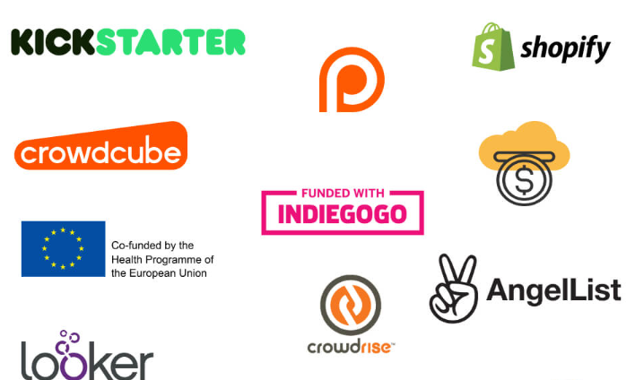
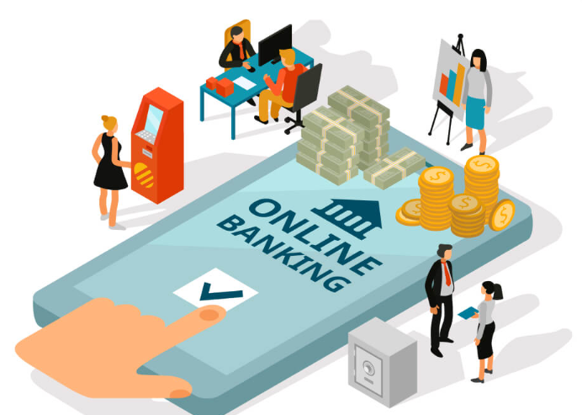

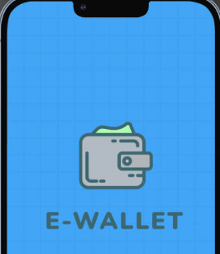
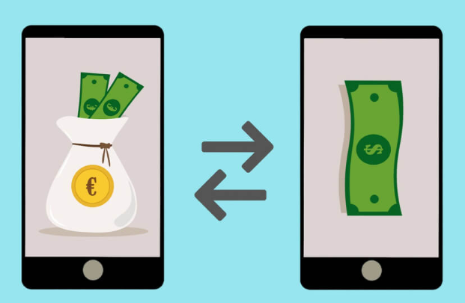
The FinTech Industry and its Products
The Financial Technology (FinTech) Industry has seen enormous growth and has captured more impact-related investment funds than any other industry.
It has attracted the attention of many stockholders who want to invest in new business ideas.
The value of the FinTech companies in the United States generated 79 billion US dollars of value
Some popular FinTech products (apps) are: digital banking, Investment, P2P Payment, Insurance, Money savings, Crypto exchange platform, RegTech Apps, and crowdfunding.
[5]
[5]

Slide 5

A promising investment trend to focus on is crowdfunding. Through crowdfunding, people can raise money with the help of friends, family, individual investors, or customers.
[4]
The market of crowdfunding is expected to reach $300 billion by 2025, and some projects are expected to generate 17.2 billion per year. [5]

Slide 6
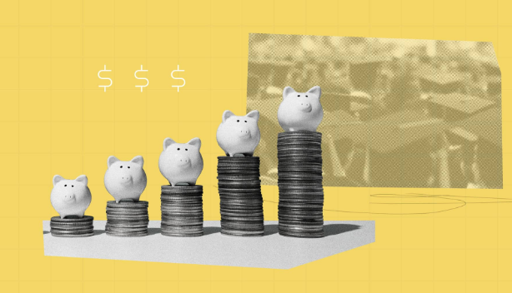

Education: A Market to Focus On
Americans believe college costs hold people back from pursuing higher education
In a survey done by National Opinion Research center (NORC), 75% cannot afford the cost of college
A big concern for students is student debt. Only 8% of students are confident that they will successfully be able to pay for college
Grants and scholarships are available to help fund educational costs however it is not enough
40% of crowdfunding investments are focused on business and entrepreneurship, while only 20% focus on social causes (Stevanovic, 2022).
[2]
[3]

Slide 7

RAINCOAT
An innovative use of social finance to make academic scholarship more accessible for deserving students in need.

Slide 8
Purpose
There are approximately 19 million students in the US pursuing higher education, each with their own unique stories, dreams, and aspirations.
Every student’s journey is different and the financial gap for college tuition and fees remains apparent. Along with encouraging every student in their growth process, support through sufficient scholarship assistance to deserving students working towards their degree and giving back to the community with their skills.

Slide 9
Our Vision
Create a platform that allows students to showcase their current path on their career journey in
Students can share their profiles anywhere and attract people to sponsor
Looking for consistency–supporters offer a set amount monthly in small increments
Seeks larger grants from corporations partnered with us

Slide 10
Target Audience
Can be a Student or a RainCoat but there is overlap
Built for anyone that needs financial support in pursuing education
Inclusivity to minority groups and people of a wide age range
Marketed in underserved areas to increase encouragement to pursue greater career

Slide 11
Product Features
User Profiles
A user can choose to be a Student, RainCoat or both. This depends on what the user decides to share, and a setting the user can toggle (whether or not they receive donations). Students share their stories about why they are asking for donations on their profiles, and RainCoats are those that adopt these students. Student profiles would also show a Student’s sponsors if there are any.
Donations
There are several types of donations that RainCoat accepts to help fund students. These will be discussed later on.
Adoptions
Adoptions are Students that RainCoats choose to donate to monthly.
Payments
The Payments feature is where Students process their school expenses through, as their received donations are kept similarly to savings accounts.These payments are tracked to make sure they are not fraudulent (not school related).

Slide 12
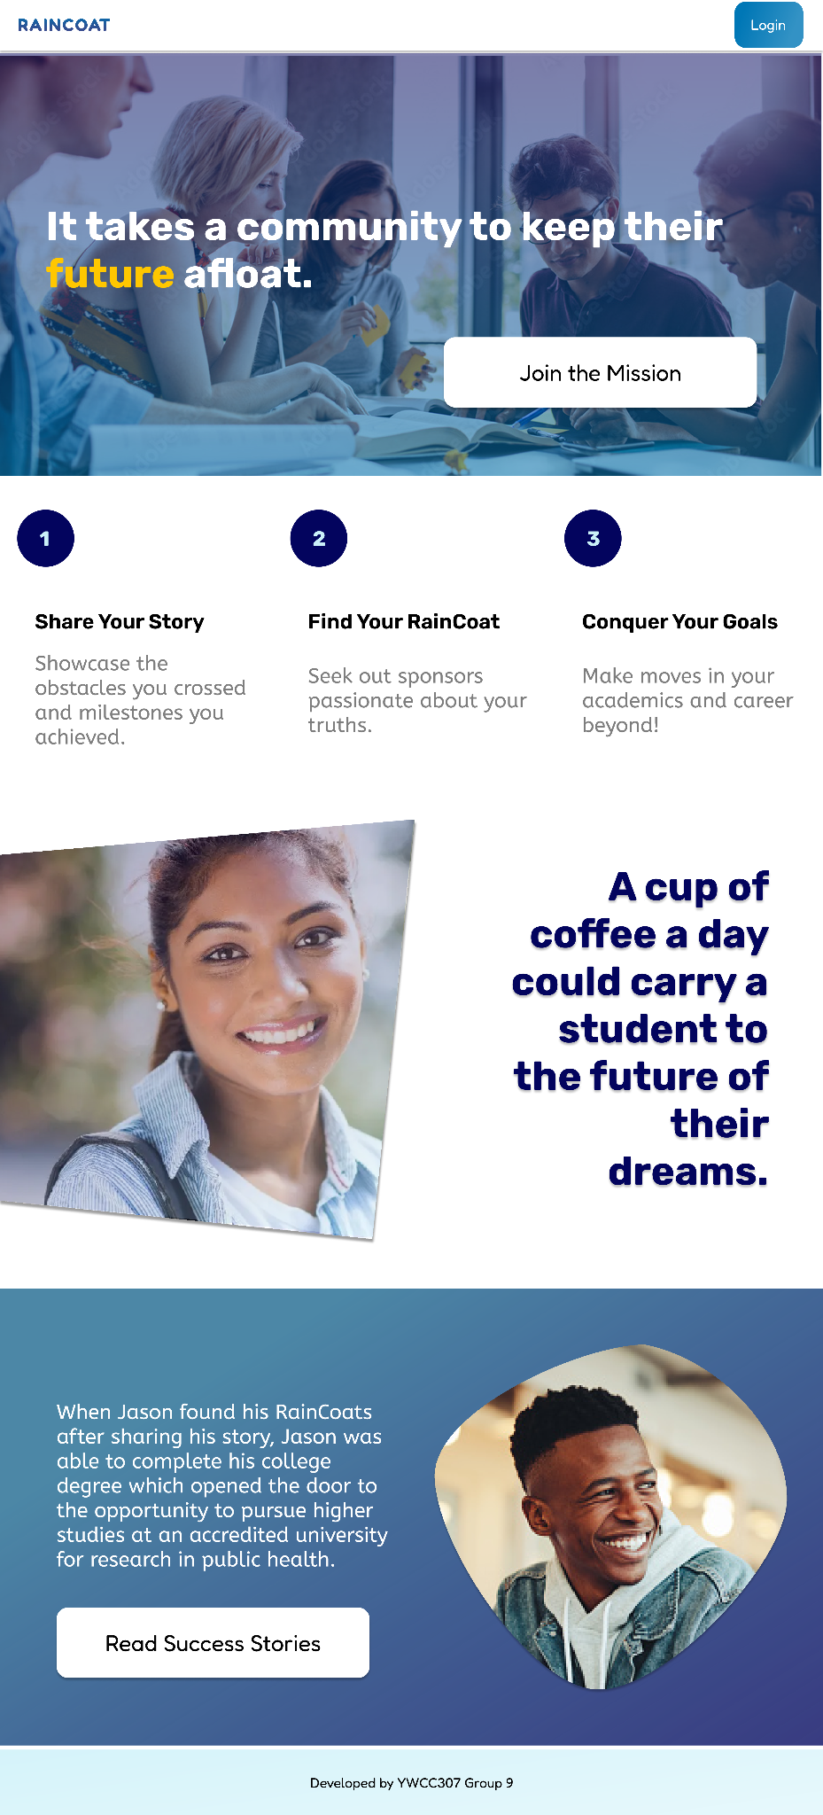
The Product

Slide 13
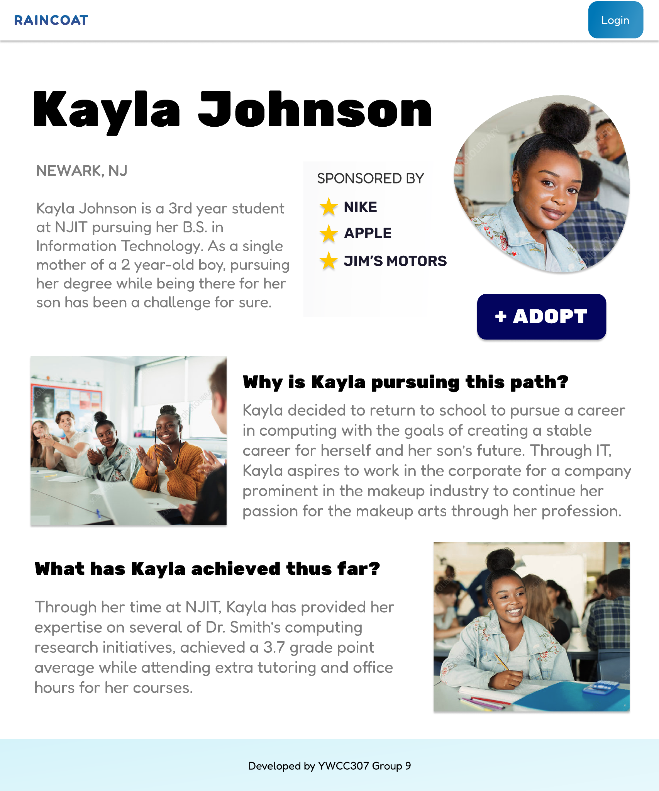
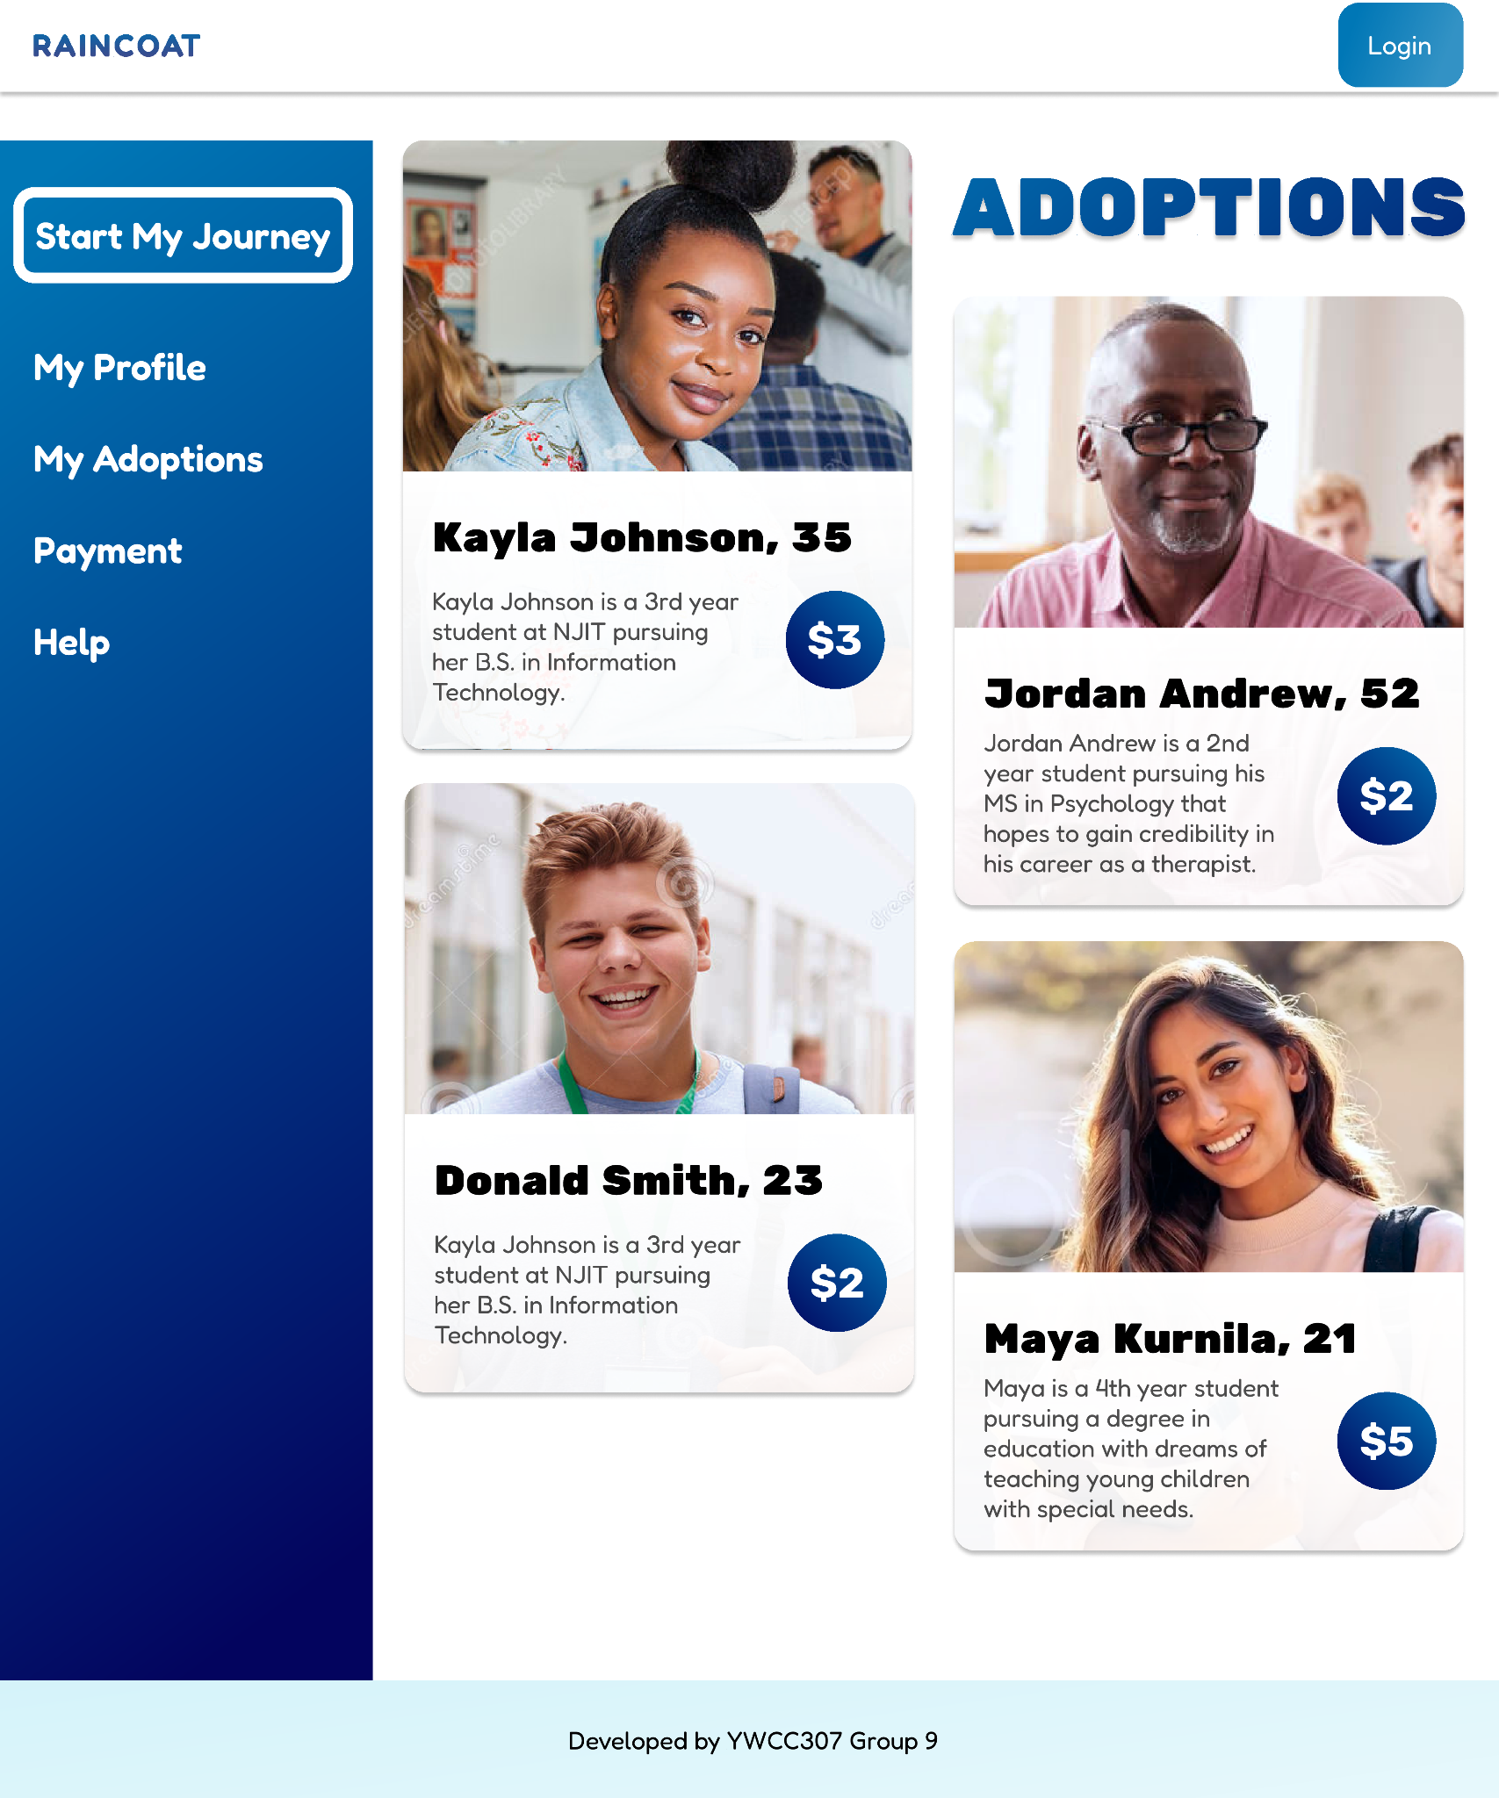
The Product

Slide 14
Types of Donations
RainCoat to Student
RainCoats are users that can choose to adopt Students which means sending monthly donations to each adoptee or they may send one-time donations.
Students who have reached their goal are able to also be RainCoats, and can choose to adopt other Students.
Round Up Donations
These donations take place when Companies partner with RainCoat. If any purchases are made on said company’s website, they would have a round-up option for customers that would fund running costs, while also going into a pool for raffles.
Raffle Donations
These donations are done with excess round-up donations or from companies that send the company money. These raffles would show as sponsored by the company, and a set number of Students would randomly get chosen to receive these donations if they enter the raffle.
Sponsors
Companies are able to sponsor Students, which would then show aa a badge on the Student’s profile and may attract more RainCoats to their profile.

Slide 15

Payment Tracking to Prevent Fraud
In order to ensure Students are properly using their donations, purchases would be tracked by having their receipts sent back to us. We would ensure that these receipts contain the school’s federal school code as a recipient. If there is no federal school code, the payment will not be processed.

Slide 16


Rewards Of Education Through Finance for the companies
Companies that invest in the education of the youth still get rewarded due to the fact because a greated educated population means they will have a larger pool of skilled professionals to hire.
Companies will also benefit from being able to write of their investments in education and the app as a donation which can be used for tax write offs which will save the company money in the long run. And will look good for the company on the public relations side.
[2]
[3]

Slide 17


How the Students Can Benefit from Finance
The students can benefit by multiple means one is the investment made by the companies directly helps students reduce certain financial obligations & burdens
The student will also be more open looking into these companies for opportunities after completing their education. This is a benefit for the students because they will have a wider eye for companies

Slide 18


How Society benefits!
Society benefits from more trained and college educated professionals. Since student can receive funding from organizations and companies they are more likely to complete their studies.
Statistics show that 38% of students dropped out due to financial hardship.
Those students who finish due to help from bigger organizations are also more likely to donate more in the long run.

Slide 19
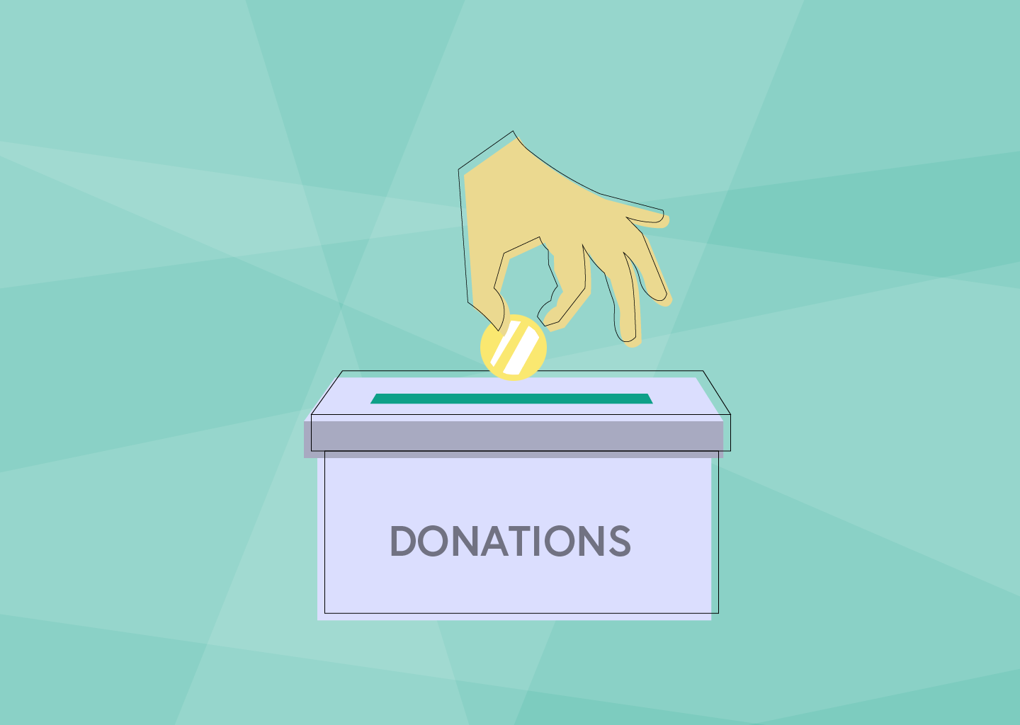
Competitors + What Makes Us Unique
Some of our competitors in this industry would be gofundme and other fundraising organizations.
What makes us unique is our focus we focus on specifically fundraising for students and having it done through big corporations. We also incentive them with the thought of the good PR they will receive but also being able to save a lot of money on tax write offs.

Slide 20
References
AppStudio. (2022, February 15). Successful fintech startup ideas to consider in 2022. AppStudio. Retrieved November 20, 2022, from https://www.appstudio.ca/blog/successful-fintech-startup-ideas/#Crowdfunding_Applications [4]
Bulger, Z., & Rouen, E. (2022, July 15). How fintech can deliver on its social impact promises. Harvard Business Review. Retrieved November 27, 2022, from https://hbr.org/2022/07/how-fintech-can-deliver-on-its-social-impact-promises [3]
Croll, D. (2022, September 18). What is Social Finance? Data in Finance. Retrieved November 25, 2022, from https://www.datainfinance.info/what-is-social-finance/ [2]
Jacobson Snyder, A. (2022, October 11). More than 3 in 4 Americans believe college is difficult to afford. Morning Consult. Retrieved November 22, 2022, from https://morningconsult.com/2022/10/11/college-affordability-student-loans-survey-data/
Kishore, K. (2022, September 30). Crowdfunding app development - cost and key features. OctalIT Blog. Retrieved November 22, 2022, from https://www.octalsoftware.com/blog/crowdfunding-app-development/ [5]
Redlin, P. (2022, August 24). Students are worried about paying for college. Edvisors. Retrieved November 26, 2022, from https://www.edvisors.com/blog/students-are-worried-about-paying-for-college/
Stevanovic, I. (2022, March 17). 40+ crucial crowdfunding stats in 2022. SmallBizGenius. Retrieved November 26, 2022, from https://www.smallbizgenius.net/by-the-numbers/crowdfunding-stats/
ESG. (n.d.). What is social responsibility to investors? ESG. Retrieved November 25, 2022, from https://www.esgthereport.com/what-is-social-responsibility-to-investors/
Images:
[1]9 Tips for Starting a Successful Crowdfunding Campaign (ideaplotting.com)
[2]More Than 3 in 4 Americans Believe College Is Difficult to Afford - Morning Consult
[3]The Importance of Higher Education | Why Does It Matter? (gradehacker.com)
[4]What is Crowdfunding Investment? - MyMoneySouq Financial Blog
[5]What is fintech and how is it changing financial products | Central Bank of Ireland | Central Bank of Ireland
[6]Most Successful Fintech Startup Ideas in 2022 (appstudio.ca)

